Slide 1
VLAN & VTP
Course Code: CSC 3116
Course Title: Computer Networks
Dept. of Computer Science
Faculty of Science and Technology
Lecturer No: | Lab 9 | Week No: | 9 | Semester: | Summer 19-20
Lecturer: | Md. Sakir Hossain, Email: sakir.Hossain@aiub.edu

Slide 2
Lecture Outline
Configuring VLANs
VTP Configuration

Slide 3
Configuring VLANs
Introduction
A technique of logically grouping of computers of LAN to limit broadcast
domain and improve security.
Each VLAN must have a LAN number
Valid numbers are 1 to 4094
Normal VLANS 1 to 1005
Stored in in vlan.dat file of Flash memory
Normally used
Extended VLANS 1006 to 4094
Stored in running configuration file
Limited options
Factory set VLANs (cannot be changed)
VLAN 1 ---Administrative VLAN or default VLAN (for Cisco switch)
VLAN 1001 to 1005 used for Token ring and FDDI networks (Not used usually)
VLAN name is optional [1]

Slide 4
Configuring VLANs….
Creation of VLANs
All configuration must be done in Global Configuration mode
VLAN Creation
Type enable to access privileged exec mode.
Type configure terminal to access global configuration mode.
Type vlan 2 to create VLAN 2 and access VLAN configuration mode.
Type name Production to name this VLAN Production.
Type vlan 3 to create VLAN 3.
Type name HR to name this VLAN HR [1].
Verify VLAN creation
show vlan brief

Slide 5
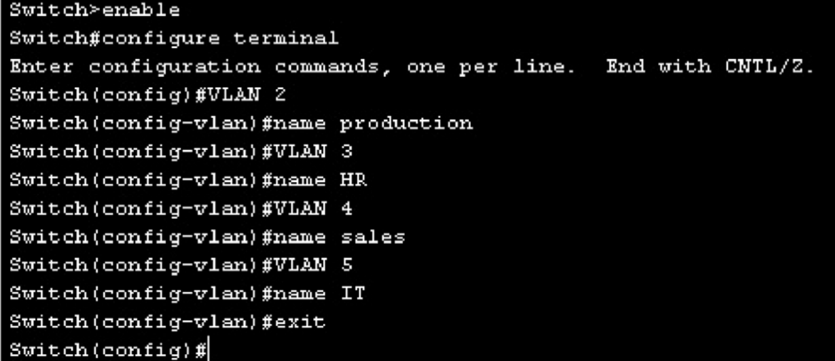
Configuring VLANs….
Cisco IOS commands for creating four VLANs

Slide 6
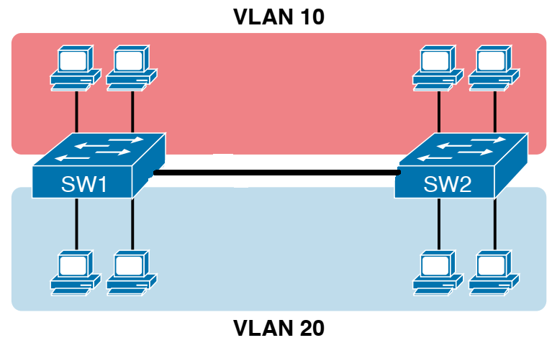
Configuring VLANs….
Modes of Interfaces
Access
Used to connect an end device such as PC
Trunk
Used to connect a connecting device such as another switch or a router to
carry data for multiple VLANs
Access
Trunk if it is configured to carry
data of multiple VLANs

Slide 7
Configuring VLANs….
Topic sub heading..
Adding interface to a VLAN
Type enable to access privileged exec mode.
Type configure terminal to access global configuration mode.
Type interface fa0/1 to access FastEthernet port 0/1.
Type switchport mode access to set this port into a nontrunking access mode.
Type switchport access vlan 2 to set this port to use VLAN 2.
Type interface fa0/2 to access FastEthernet port 0/2.
Type switchport mode access to set this port into a nontrunking access mode.
Type switchport access vlan 3 to set this port to use VLAN 2
Type interface fa0/3 to access FastEthernet port 0/3
Type switchport mode trunk to set this port into a trunking mode

Slide 8
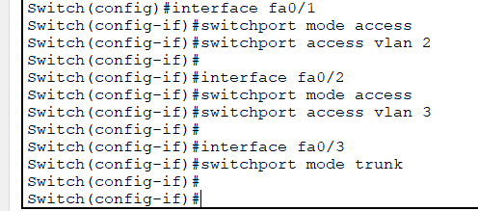
Configuring VLANs….
Commands for adding interfaces to a VLAN

Slide 9
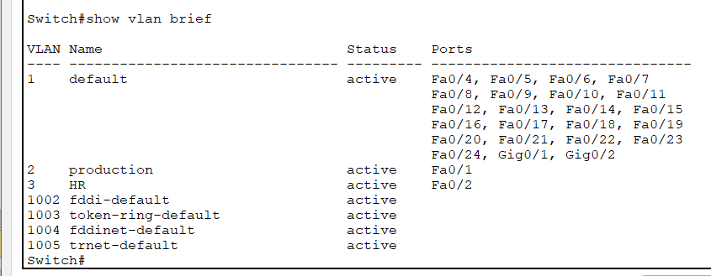
Configuring VLANs….
Verify members of a VLAN
Fa0/3
is not
shown
as it is
a trunk

Slide 10
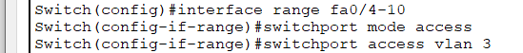
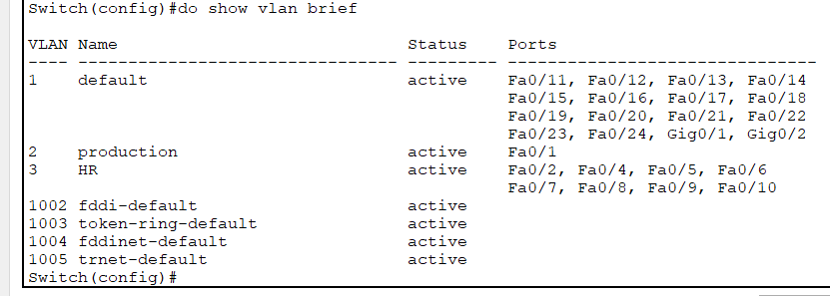
Configuring VLANs….
Adding multiple interfaces to a VLAN at a time
Adding multiple interfaces to a VLAN at a time

Slide 11
Configuring VLANs….
Verifying VLAN Information
Switch# show vlan | Displays VLAN information
Switch# show vlan brief | Displays VLAN information in brief
Switch# show vlan id 2 | Displays information about VLAN 2 only
Switch# show vlan name HR | Displays information about VLAN HR only

Slide 12
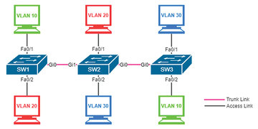
VTP Configuration
VTP configuration commands
Suppose
SW1: Sever
SW2 & SW3: Client
A
B
C
SW1
Switch(config)# vtp mode server
Switch(config)# vtp domain aiub
Switch(config)# vtp password 123
D
E
F
SW2
SW3
Switch(config)# vtp mode client
Switch(config)# vtp domain aiub
Switch(config)# vtp password 123
Switch(config)# vtp mode client
Switch(config)# vtp domain aiub
Switch(config)# vtp password 123

Slide 13
Topic Heading..
VTP configuration verification
Verifying VTP
Switch# show vtp status | Displays general information about VTP configuration
Switch# show vtp counters | Displays the VTP counters for the switch

Slide 14
References
[1] D. Liu, Cisco CCNA/CCENT Exam 640-802, 640-822, 640-816 Preparation Kit, Syngress
Publishing, Inc., 2009, pp. 549-567.
[2] W. Odom, Official Cert Guide CCNA 200-301 Volume 1, Pearson Education, Inc.,
2020, USA, p. 181.

Slide 15
Books
1. Official Cert Guide CCNA 200-301 , vol. 1, W. Odom, Cisco Press, First Edition, 2019, USA.
2. CCNA Routing and Switching, T. Lammle, John Wily & Sons, Second Edition, 2016, USA.

